Slide 1
Sprint 3 – Prototype( )
End of tutorial phase
Begin creation and prototyping phase
Product Owner: Chris
Scrum LORD!!!: Billy
Developers: Dane, Gabe, Michael

Slide 2
Dane’s Sprint 3 Goals
Create the player’s army using a basic shape
Enable basic movement around the board
- I expect to be able to create the objects for the player’s army and move them around within 8 hours of work.

Slide 3
Dane’s Sprint 3 Accomplishments
Created an array to store “archers” in
Discovered how to create a “Prefab”
Wrote functions that enable movement around the board
Lots of debugging skills that led to turning off a lot of the Unity default settings to cure wacky behavior of objects
Created interface functions that can track health (with applicability to later increments)
*I put in 10 hours of work to accomplish this week’s increment.

Slide 4
Michael's Sprint Goals
Design a basic main menu UI
Create a basic submenu navigation system
Ensure that future features are accounted for in the main menu UI design.
Hours Expected
  5 hours were on board. I expected it would take a couple more...

Slide 5
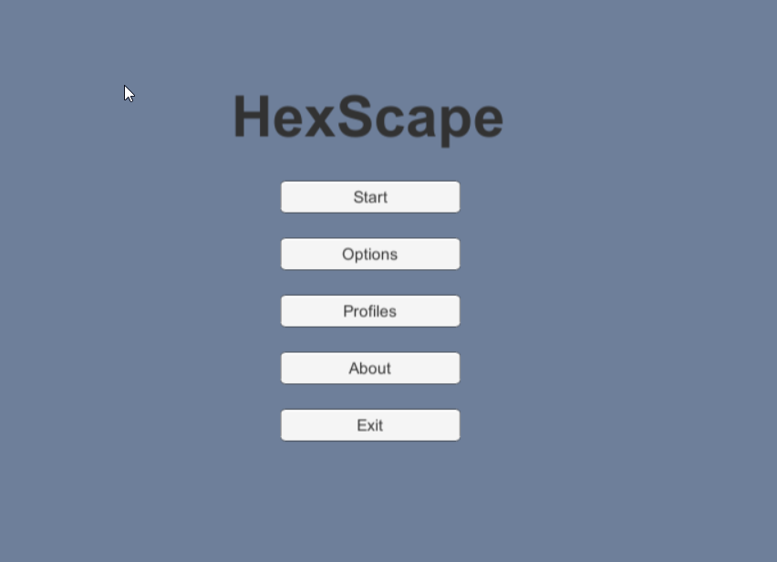
Menu Screenshot

Slide 6
Michael's Results
Created a main menu along with sub menus.
  One parent main menu.
  Three children sub menus – Options, Profile Select, About.
Created a couple basic scripts that hide all other menus not in use and show only the currently selected menu.
Actual time spent: 7 hours

Slide 7
Gabe’s Sprint 3 Goals
Create the Unit class that will handle unit data
Set up MySQL and learn the basics of creating and managing databases.
Create the database table that will hold data for all units
I expect to be able to create units, both-player controlled and non-character, and have a database table for character data within 8 hours of work.

Slide 8
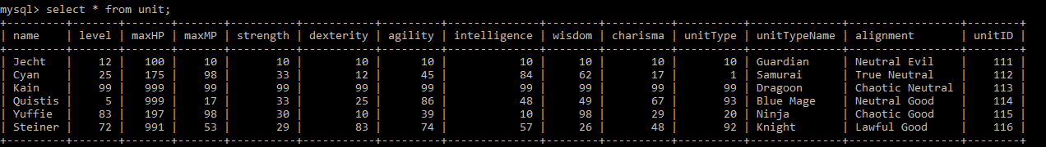
Gabe’s Sprint 3 Accomplishments
Created the basic unit class. It still needs work but can serve as a starting point for future design work.
Created a database schema containing a table for units and populated the instance with sample data.
I put in 8 hours of work to accomplish this.

Slide 9
Billy's Sprint 3 Goals
Work on 3D modeling
  - Create a variety of 'units' to move around a game board
  - Create some terrain objects, structures, etc to get in the way of the units and make the board less blah

Slide 10
Billy's Sprint 3 Accomplishments
Created a series of chess units in Blender
Loaded them onto a game board in Unity
Successfully imported outdated project from Unity

Slide 11
